Slide 1
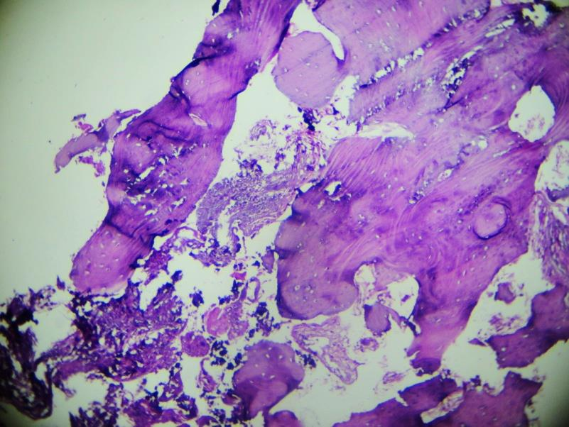
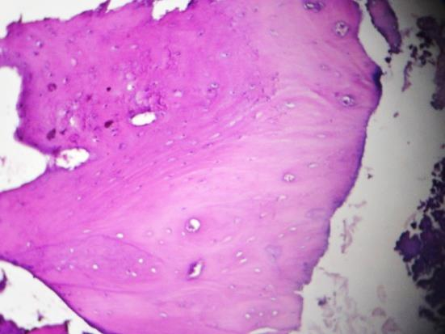
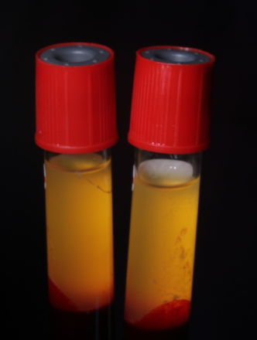
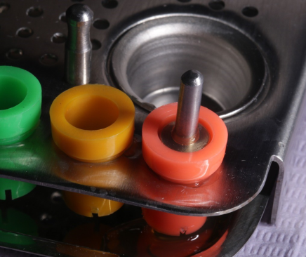
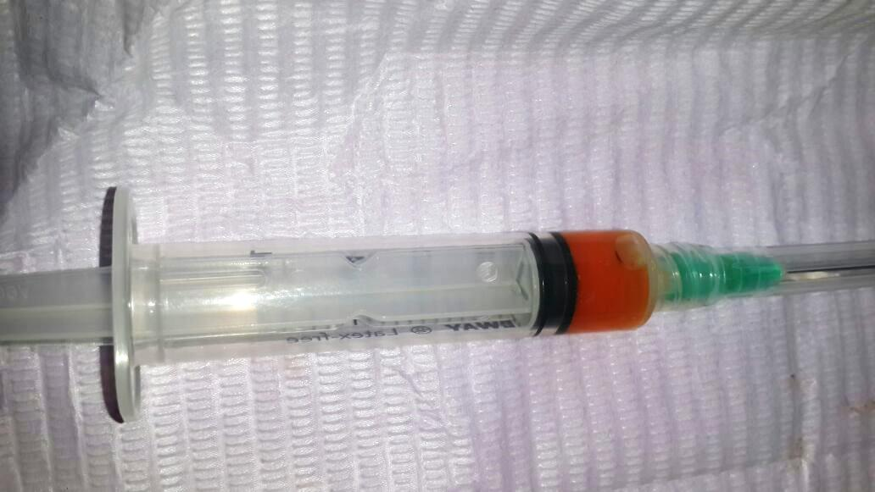
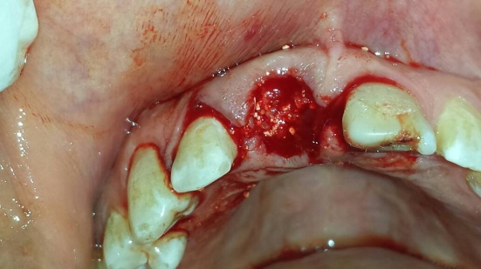
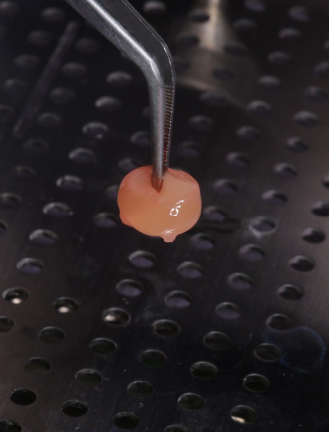
Bone Regeneration in Extraction Socket Grafted with Resorbable Bioactive SCPC Dental Bone Graft. A Case Report
Rania A. Fahmy¹ DDS, PhD, Ahmed El-Ghannam², PhD
¹Lecturer, Department of Oral Medicine and Periodontology, Faculty of Dentistry, Alexandria University, Alexandria, Egypt. ²Associate Professor, Department of Mechanical Engineering and
Engineering Science, University of North Carolina at Charlotte, Charlotte, NC.
Introduction
Loss of hard and soft tissue after tooth extraction can impede proper prosthetic restoration using dental implants. Socket preservation procedures have been reported to minimize resorption of tissue and maximize bone formation inside the socket. Several calcium phosphate materials have been used for socket preservation, however with variable degrees of success due to limited graft bioactivity and resorbability. For example, the poor resorption of the hydroxyapatite have interfered with the osteogenic activities and tissue regeneration which compromised successful dental implant placement [1]. In the present study, we report on the use of a novel resorbable bioactive Silica-Calcium Phosphate Composite (SCPC) bone graft for socket preservation. Cone beam computed tomography (CBCT) and histology of core bone biopsy confirmed Bone regeneration and graft material resorption in the extraction socket six months post operative.
Results
A
B
C
Fig.5. Light micrograph of core bone biopsy taken six months post operative showing new bone formation inside the healing extraction socket. Dense thick bone trabeculae with surrounding connective tissue stroma is seen. Resorption of the SCPC graft material is evident. H&E x40
Methods
Fig. 3. (A) Six months reentry with flap reflection for implant placement revealing intact buccal plate almost at the level of that of the neighboring tooth. (B & C) sagittal cut for one and six months CBCT showing newly formed bone at the apical part with minor remaining particles at the socket orifice and intact buccal plate of bone (arrow). Alveolar ridge width decreased from 6.55 to 5.98 mm and alveolar ridge height decreased from 17.9 to 16.7 mm
A 23 year old female presented to the clinic to restore a hopeless upper right central incisor with a dental implant. The hopeless tooth was atraumatically extracted. SCPC bone graft granules (Shefabone, Inc, NC, USA) were used to fill the extraction socket to preserve its dimensions for future implant placement. SCPC was mixed with injectable platelet rich fibrin (i-PRF) to prepare sticky bone then a PRF membrane was prepared to cover the SCPC filled extraction socket (Fig. 1). The (i-PRF) was prepared by blood centrifugation (700 rpm for 3 min) according to the protocol developed by Choukroun [2]. The PRF membrane was similarly prepared at 2700 rpm for 12 minutes (Fig. 2).
A cone beam computed tomography CBCT was taken one and six months postoperatively to analyze bone healing.
A core biopsy was taken after six months for histology analysis of the newly formed bone and SCPC graft resorption .
A
B
Fig. 4. (A) One month and (B) Six months postoperative CBCT showing healing of SCPC filled extraction socket. Note increased bone density and preserved alveolar ridge dimensions and soft tissue papilla.
A
A
B
C
A
B
C
B
Fig. 6. Higher magnification showing thick bone trabeculae with reversal lines and large trapped osteocytes (white arrows). Osteoblasts (yellow arrows) can be seen lining the new bone trabeculae indicating active remodeling. (A) H&E x100
(B) Gomri trichrome
D
E
F
D
E
Conclusion
CBCT and histologic analyses of core biopsy demonstrated bone regeneration and SCPC graft resorption in extraction socket; six month postoperative.
The newly formed bone consisted of thick mature bone trabeculae showing osteocytes and reversal lines with osteoblasts lining the trabeculae indicating active remodeling. In conjunction with bone regeneration, near complete resorption of the SCPC granules was observed.
The successful alveolar socket preservation and the formation of dense mature bone in our case report are consistent with the data in the literature that shows that silica stimulates osteoblast differentiation and downregulate osteoclast activity [3].
Fig. 1. (A) The hopeless upper right central incisor indicated for extraction, (B) SCPC bone graft prior to mixing with i-PRF, (C, D & E) preparation of i- PRF and mixing it with the SCPC, (F) extraction socket filled with the SCPC/i-PRF.
Fig. 2. (A &B) preparation of the PRF membrane, (C & D) PRF membrane shaped into a disc to cover the SCPC granules grafted in the extraction socket, (E) 3 weeks healing of the alveolar socket showing good soft tissue healing and preserved ridge dimensions
References
Zvi Artzi, et al. Porous Bovine Bone Mineral in Healing of Human Extraction Sockets. Part 1: Histomorphometric Evaluations at 9 Months. J Periodontol, 2000;71:1015-1023
Choukroun J. Advanced PRF & i-PRF: Platelet concentrates or blood concentrates? J Periodontal Med Clin Pract 2014; 01: 3
Zivko Mladenovic,et al, Soluble silica inhibits osteoclast formation and bone resorption in vitro, Acta Biomaterialia, 10 (2014) 406–418

