Slide 1
Endodontics
56 year old Caucasian female was diagnosed with Asymptomatic Periapical Periodontitis on lateral aspect of the tooth #4 and biopsy came back as a cyst measures (1.2cm x 2 cm)
Medical History: Mitral Valve Prolapse in 2012
2 lateral canals found, prepared and filled using bioceramic filling material (putty).
The cyst (and granulation) tissue was removed and The SCPC was soaked in local anesthetic.
The defect was filled with SCPC granules, Flap was sutured.

Slide 2
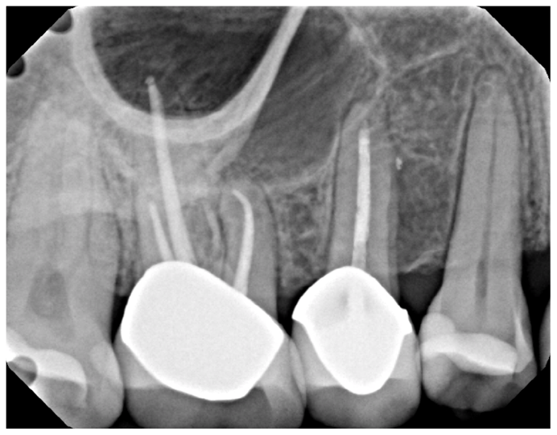
Pre-op
Lateral lesion noted #4

Slide 3
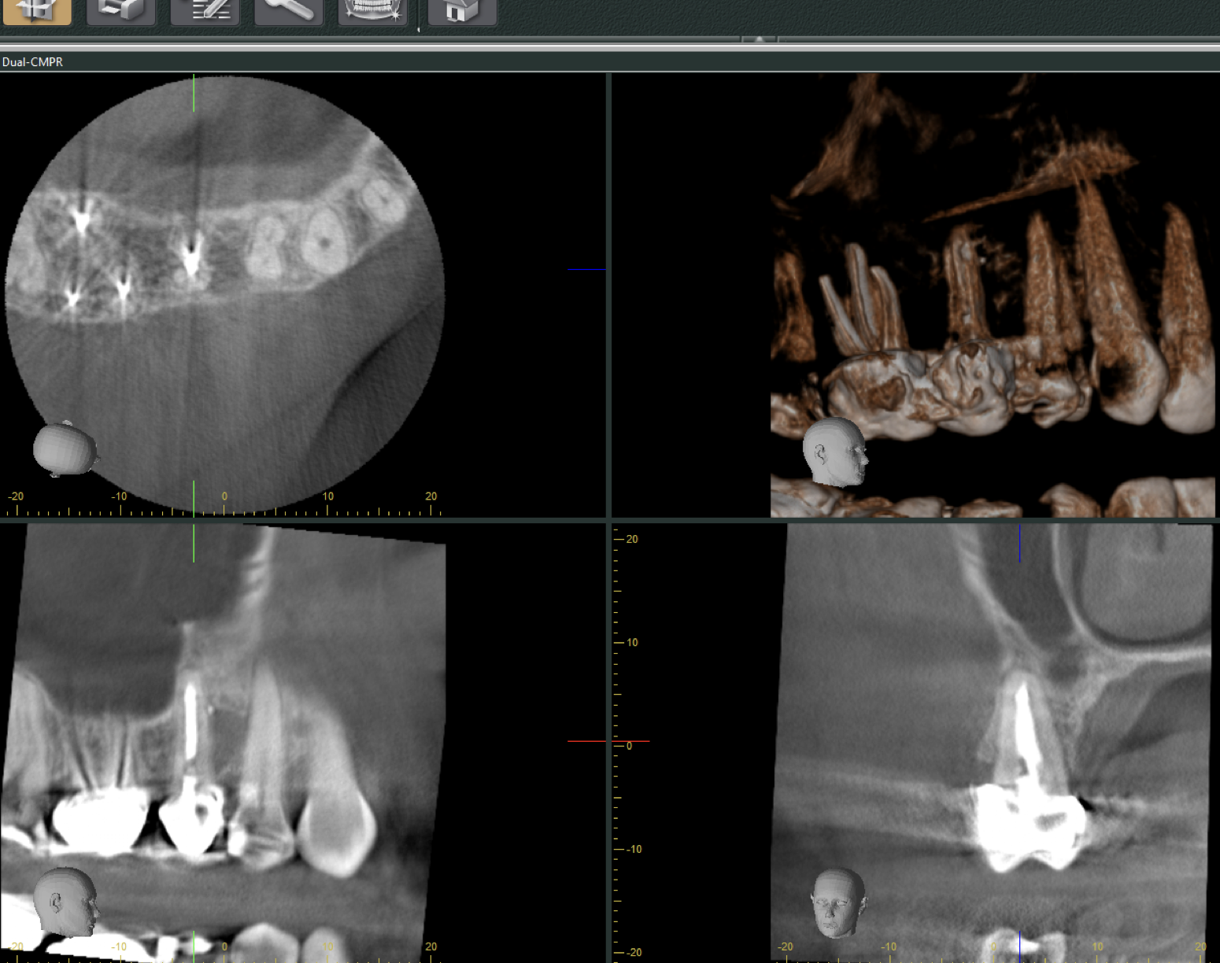
CBCT
Lateral lesion confirmed

Slide 4
Immediately Post-op
Two lateral canals cleaned and filled
Shefabone placed

Slide 5
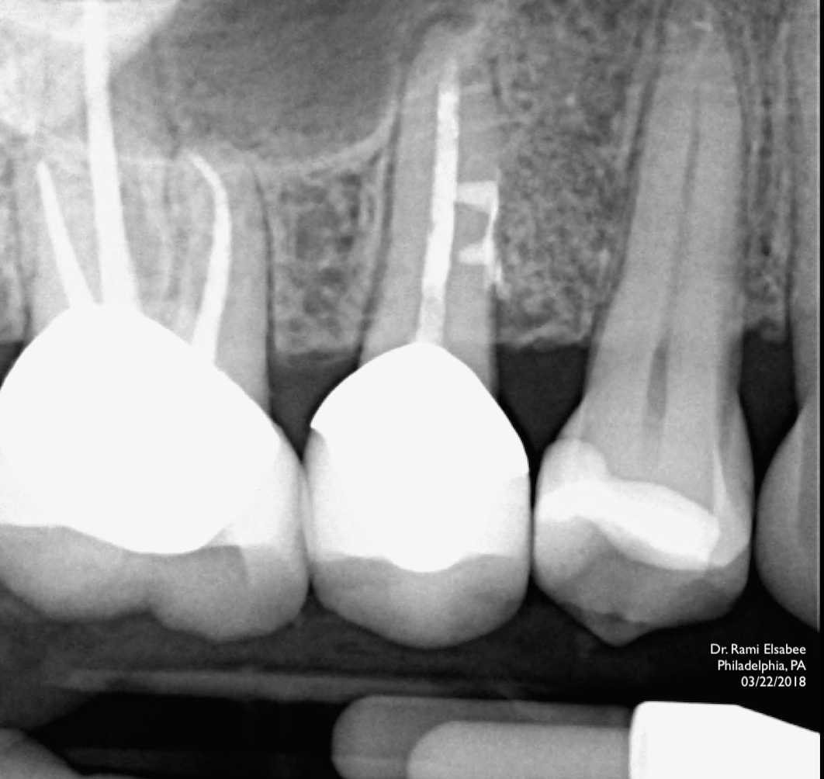
Immediately Post-op
Two lateral canals cleaned and filled
Shefabone placed

Slide 6
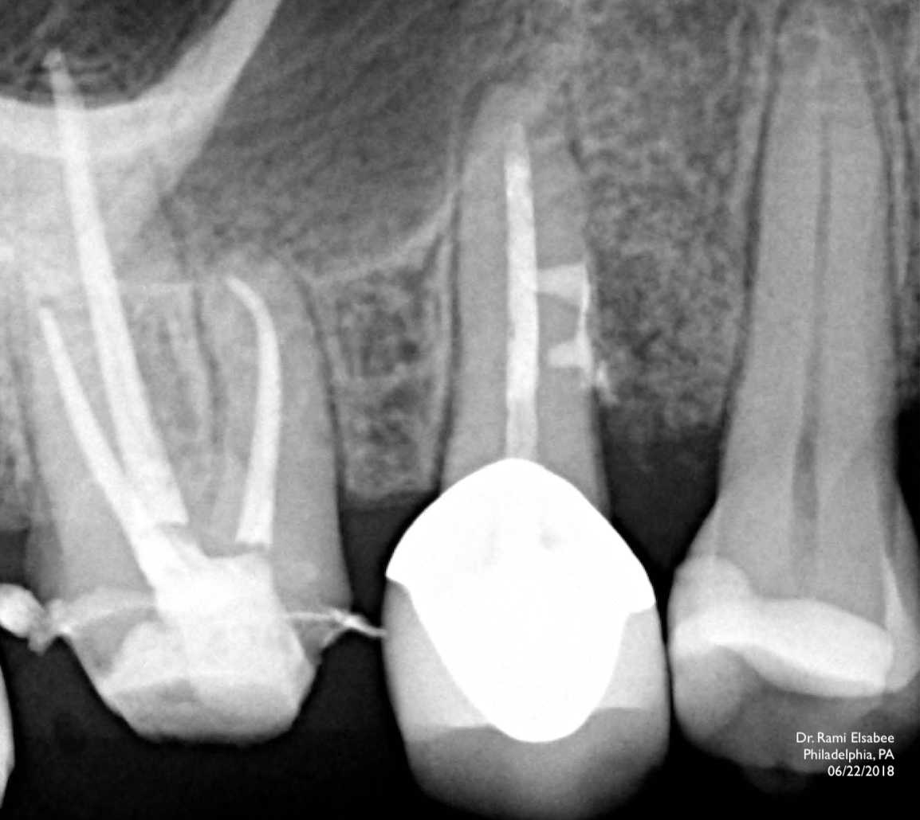
3 months follow-up

Slide 7
6 months follow-up
7 months follow up 10/05/2018

