Slide 1
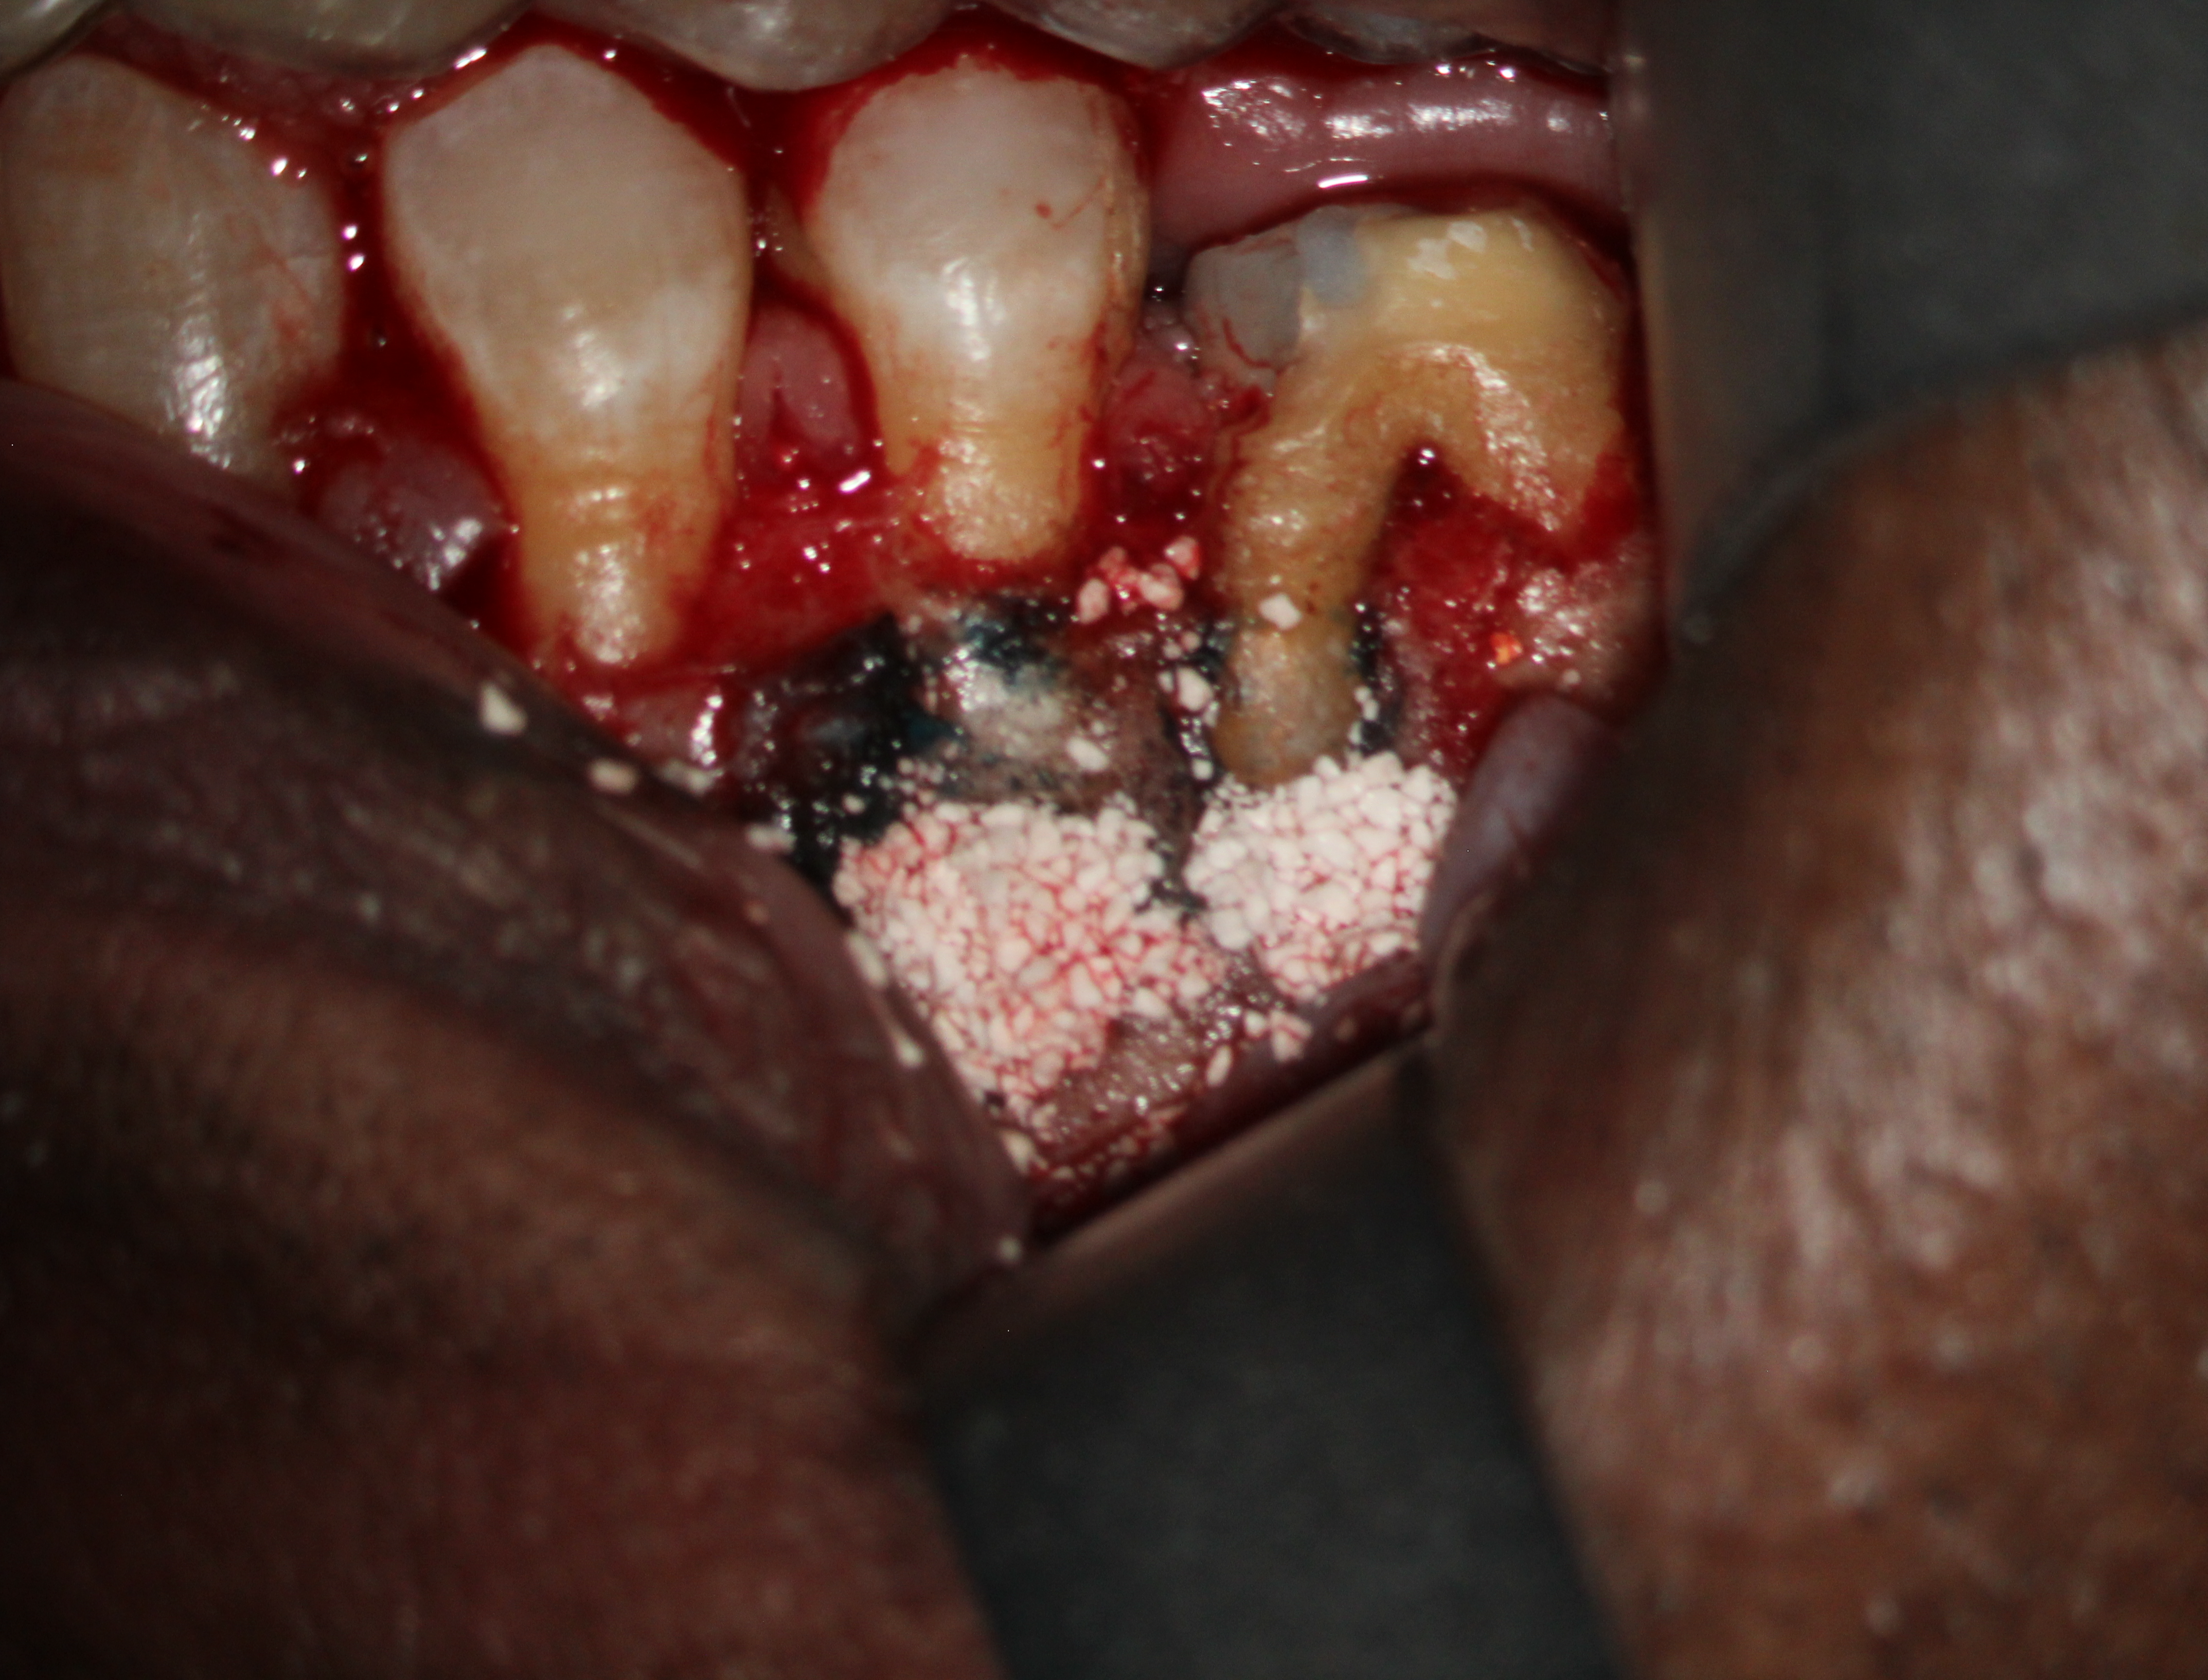
A
A: Preoperative X-ray radiology showing infect bone (arrows) at the roots of teeth number XX and YY
B: Digital image showing Shefabone SCPC granules inside the defect after removal of the granulation tissue.
B

Slide 2
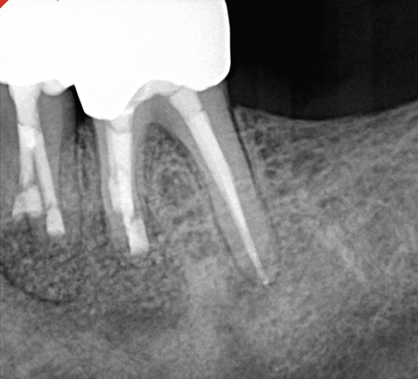
Immediately post operative
X-ray radiograph showing the SCPC granules inside the defect (Arrows)

Slide 3
3 months post operative
X-ray radiograph showing bone regenrationa nd graft material resorption inside the defect
The radiopacity of the newly formed bone matches that of the host bone

