Slide 1
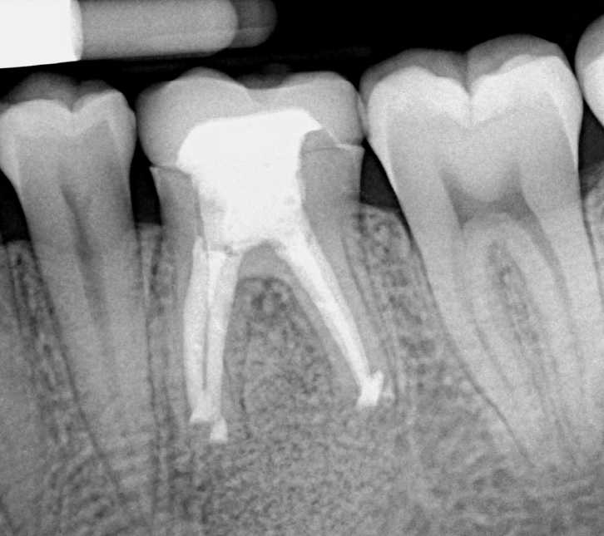
A: X-ray radiography immediately post operative showing the SCPC particles grafted in the defect.
B: X-ray radiography showing new bone formation inside the defect after 3 month.

